Slide 1


Slide 2
I2SL Vision and Mission
Vision
  I2SL will be the global leader and primary resource connecting stakeholders and providing information and education to ensure safe, sustainable, and decarbonized laboratory design, operation, and use.
Mission
  To engage diverse types of stakeholders in advancing the safety, sustainability, and decarbonization of laboratories and other high-tech facilities globally.

Slide 3
I2SL History and Structure
Initially Laboratories for the 21st Century (Labs21); in 2005, EPA and DOE’s Federal Energy Management Program (FEMP) signed an MOU with Phil Wirdzek to transition Labs21 to I2SL
Formed as a 501(c)(3) nonprofit organization in 2006
Led by a Board of Directors of 14 volunteers
Managed and staffed by environmental consulting firm ERG
Operating 15 U.S. chapters and three international affiliates
Affiliate groups: University Alliance, Sustainable Lab Forum for corporate owners, Lab Materials Management Working Group

Slide 4
I2SL Members and Chapters
I2SL Membership: 600+ individuals, institutions, and lab owners
    Architects, engineers, builders, consultants, green labs professionals
    Agencies, nonprofits, academic institutions, and corporate lab owner companies
I2SL Chapters: city, state, or regional groups of professionals
  Arizona
  Colorado
  Georgia
  Great Lakes
  Greater Los Angeles
  Greater New York
  Heart of America
National Capital
New England
North Carolina-Triangle
Northern California
Pacific Northwest
San Diego
St. Louis
Texas
International Chapters
Australia
United Kingdom
China

Slide 5
I2SL Membership Benefits
Annual Conference, workshop, and virtual education discounts
Subscription discount on Actionable Insights and Measures Report
Free access to all I2SL live webinars, webinar recording archive, and Annual Conference presentation slides
Free or discounted registration to many chapter events
Qualification to participate in Technical Advisory Councils/Groups
Institutional or corporate membership that gives benefits to all employees (and students) for one price

Slide 6
I2SL Activities
Annual Conference & Technology Fair
Laboratory Benchmarking Tool to compare energy use to peers
Labs2Zero program to help reduce energy and operating costs
Promotion and support for chapters and working groups
Circular Economy for Labs Community of Practice site and forums
Virtual education events and technical webinars
International Freezer Challenge co-sponsor
Smart Labs Toolkit on website in partnership with FEMP

Slide 7
I2SL Chapters [Customize for chapter]
15 regional chapters across the United States and three international affiliates
Run by industry professionals who volunteer their time
Plan educational and networking events such as lab tours, golf tournaments, breweries, and presentations
Many chapters offer free or discounted registration to their events to I2SL members
Collect sponsorships for the chapter or specific events

Slide 8
Annual Conference & Technology Fair
Premier in-person conference focused on laboratory sustainability, efficiency, and decarbonization
40+ technical sessions, pre-conference workshops, tours of cutting-edge labs, networking, and more
Exhibit hall featuring sustainable services and technologies from some of the world’s top vendors
Sponsors who receive recognition on website, mobile app, signage, and may qualify for complimentary registration

Slide 9
I2SL Education Events
Virtual, international learning opportunities for those who cannot attend the Annual Conference in person or looking to hear more from about international speakers and topics
Live presentations from industry experts and recordings of all sessions available to registrants
System optimization, decarbonization, sustainable design, and green labs from the U.S., Canada, UK, Europe, Australia, China
Webinars recorded, 100 percent remote

Slide 10

I2SL Laboratory Benchmarking Tool
Rich database of lab building attributes, energy use
Foundation of all the Labs2Zero tools
Benchmarking lab buildings’ energy intensity against similar facilities’ performance in the same climate zone
Filters allow for more specific comparisons
Features international units/climate zones
All facilities with data can access a free scorecard with 1-100 Energy Score/Operational Emissions Score
We now have 1,400+ buildings in the LBT!
https://lbt.i2sl.org

Slide 11
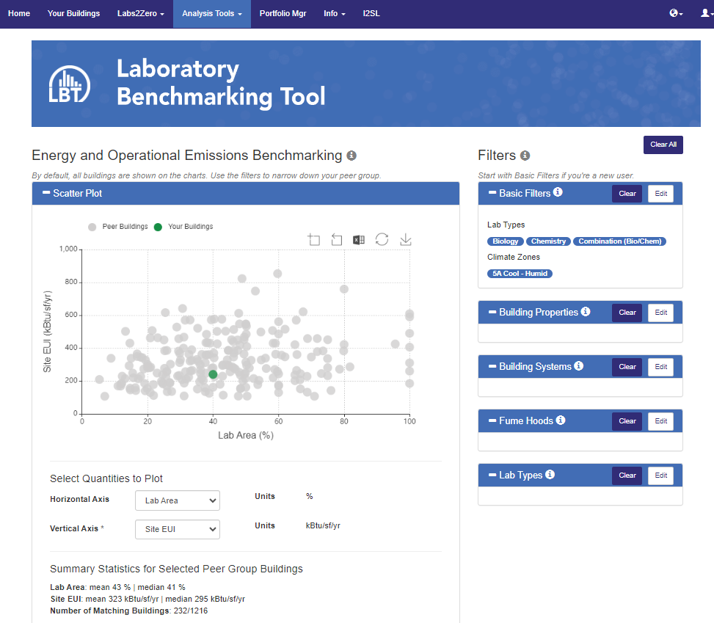

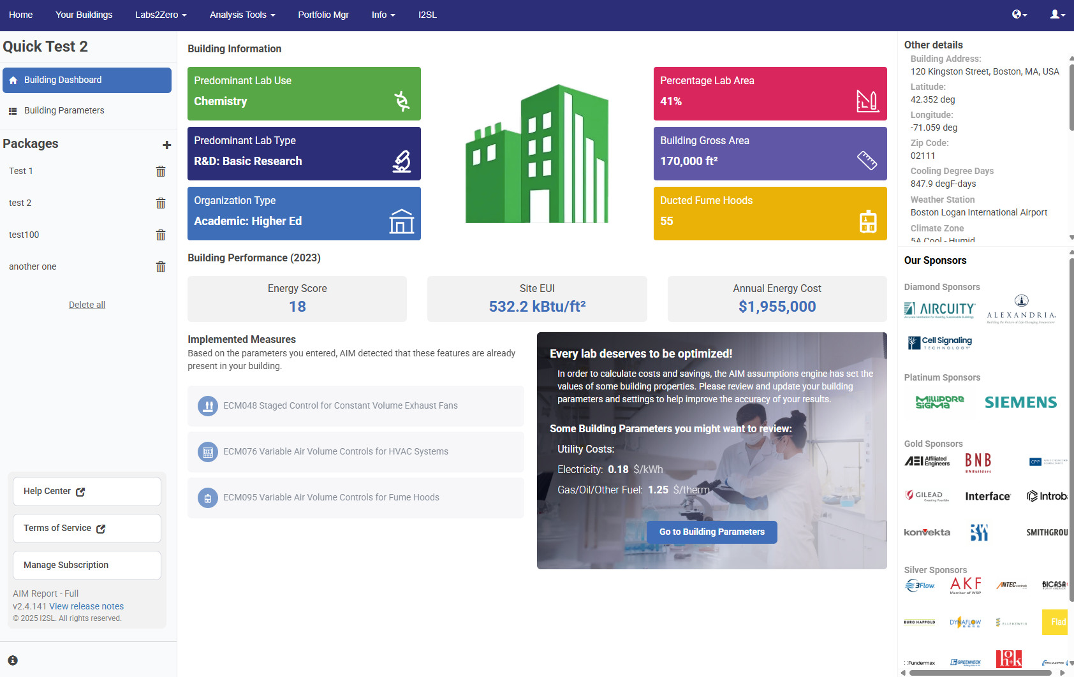

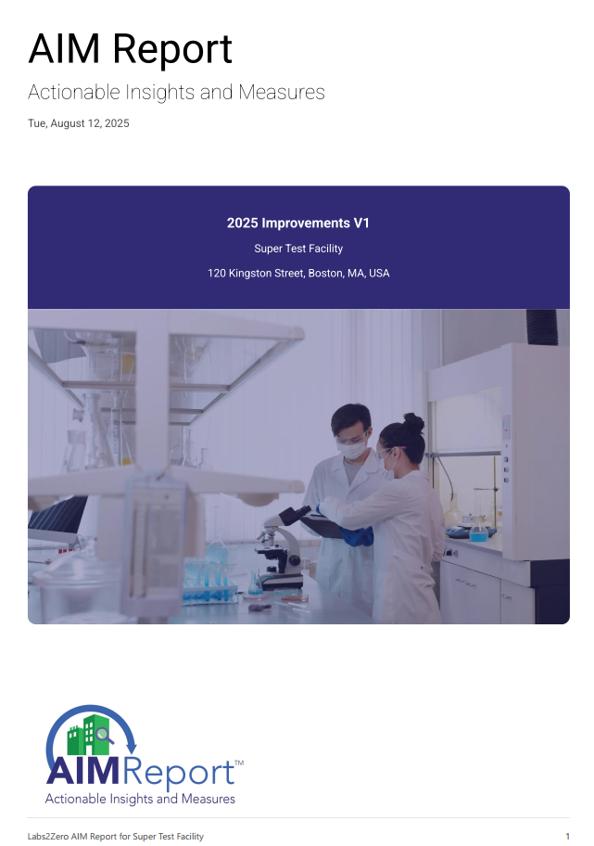
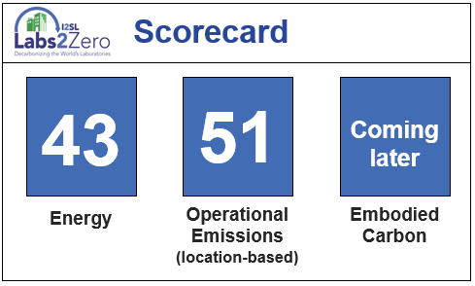





Labs2Zero Tools and Opportunities
Performance Assessment
Performance Improvement
Professional Accreditation
Notes:
Labs2Zero is one of I2SL’s largest programs supporting our mission to help labs reduce energy, emissions, and operational costs.
The Labs2Zero tools are all based on the free Lab Benchmarking Tool, a peer database of over 1,400 lab buildings that allows you to compare your facility’s energy performance to facilities of similar size, type, location, and more. You can also add a building’s lifecycle assessment data to benchmark its embodied carbon.
If you enter facility and utility data into the LBT, you will receive a free Energy Score and Operational Emissions Score; they assess your lab building’s performance compared to peers on a percentile basis from 1 to 100, similar to ENERGY STAR ratings. You can also set a target Energy Score for a lab building and see what your energy intensity would need to be to achieve that score.
Once you get an Energy Score for a lab building, an AIM Report can show you how to save energy and money. I’ll explain more about this software in a moment.
I2SL is also developing two different professional accreditations: Labs2Zero Champions and Labs2Zero Experts.
Champions (like me) understand and encourage ways to use the Labs2Zero tools to help improve lab buildings. Experts will be technical professionals who can train others on how to use these tools. If you are interested in becoming a Labs2Zero Champion or Expert, you can email info@i2sl.org to hear about future trainings.

Slide 12
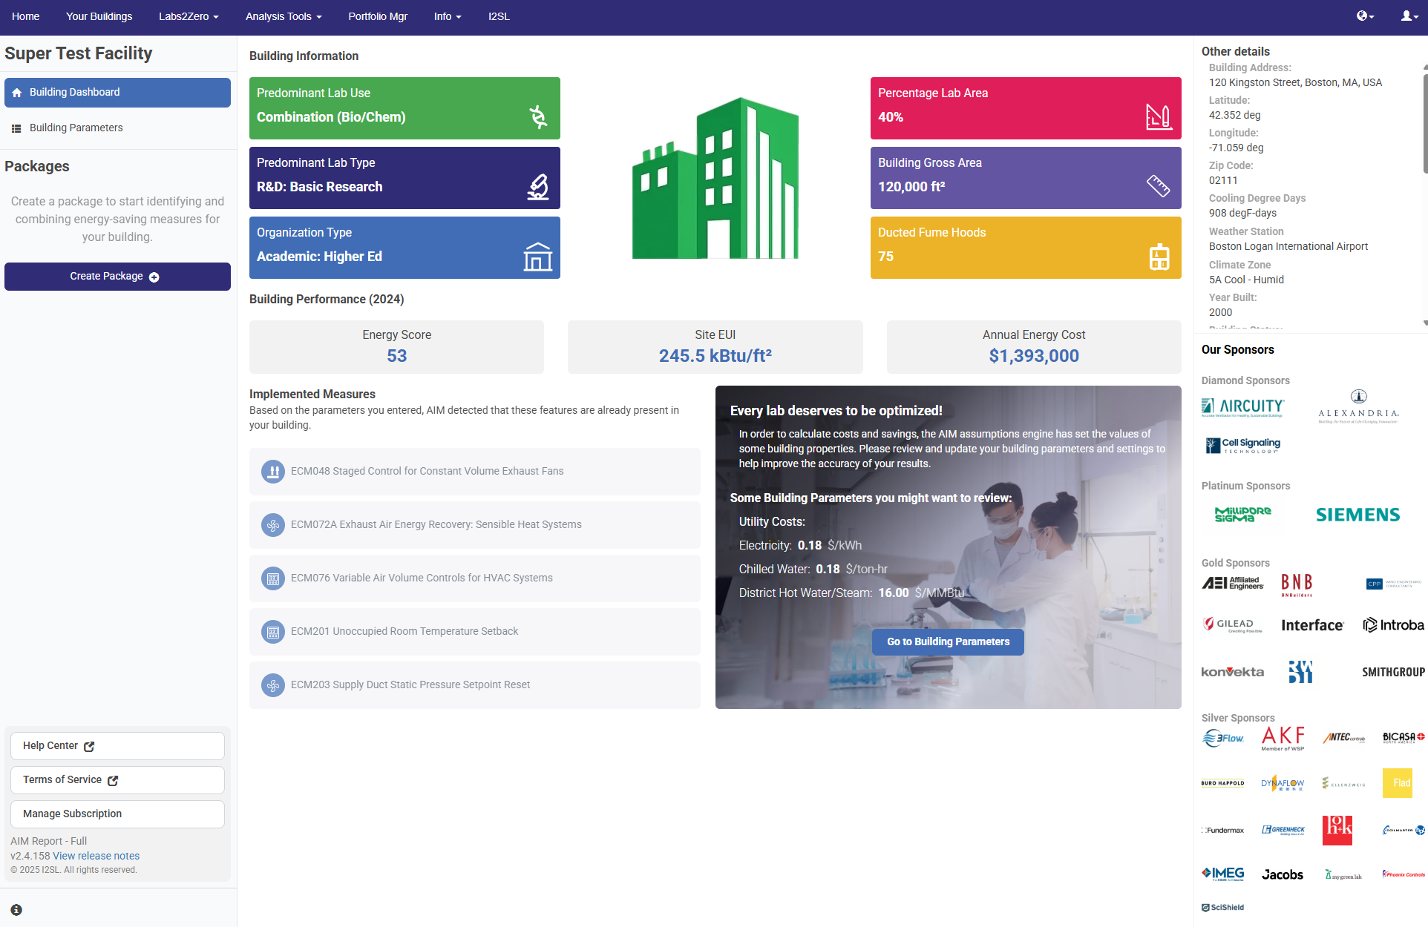
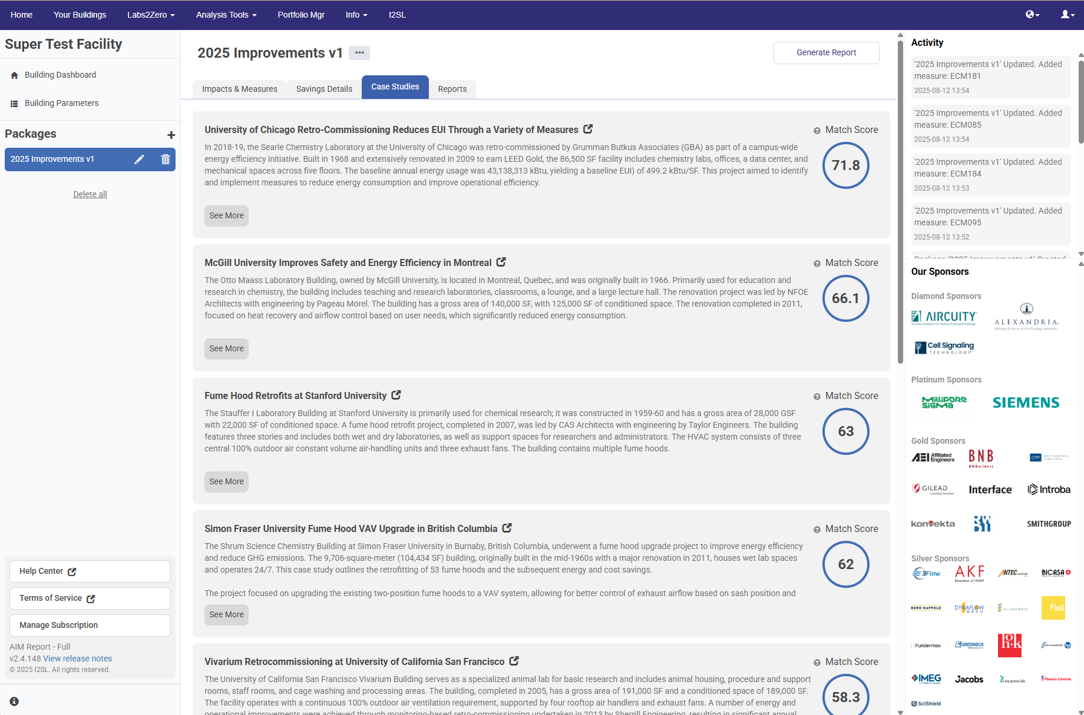
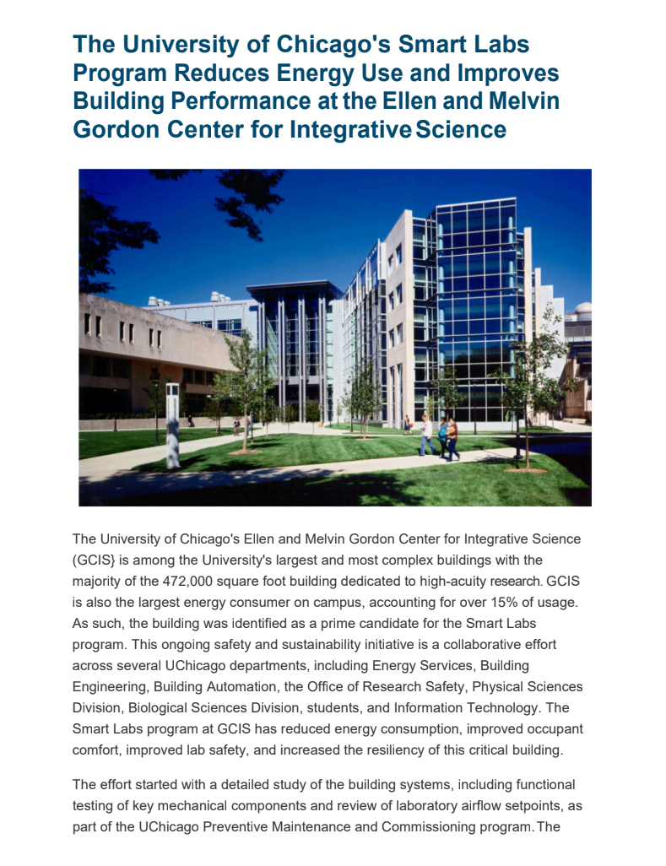
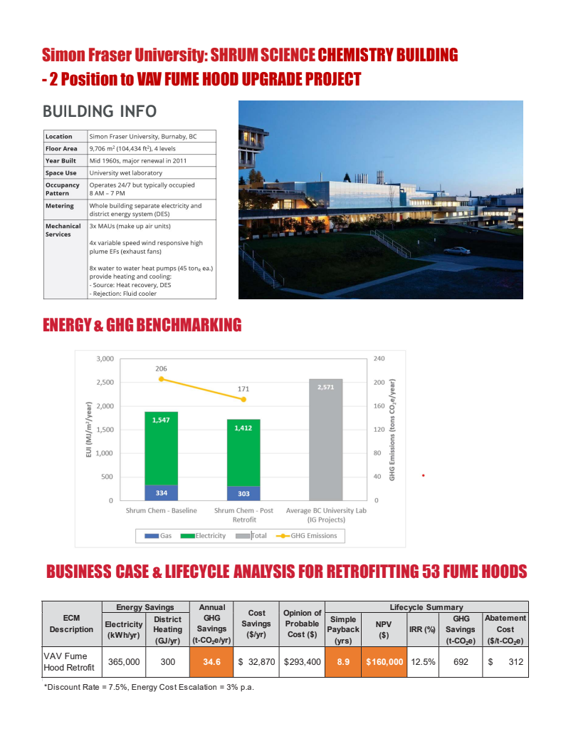
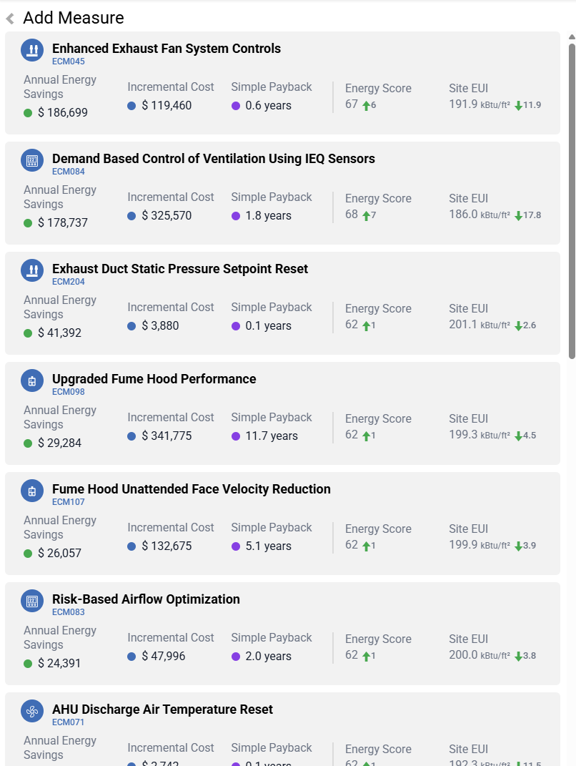
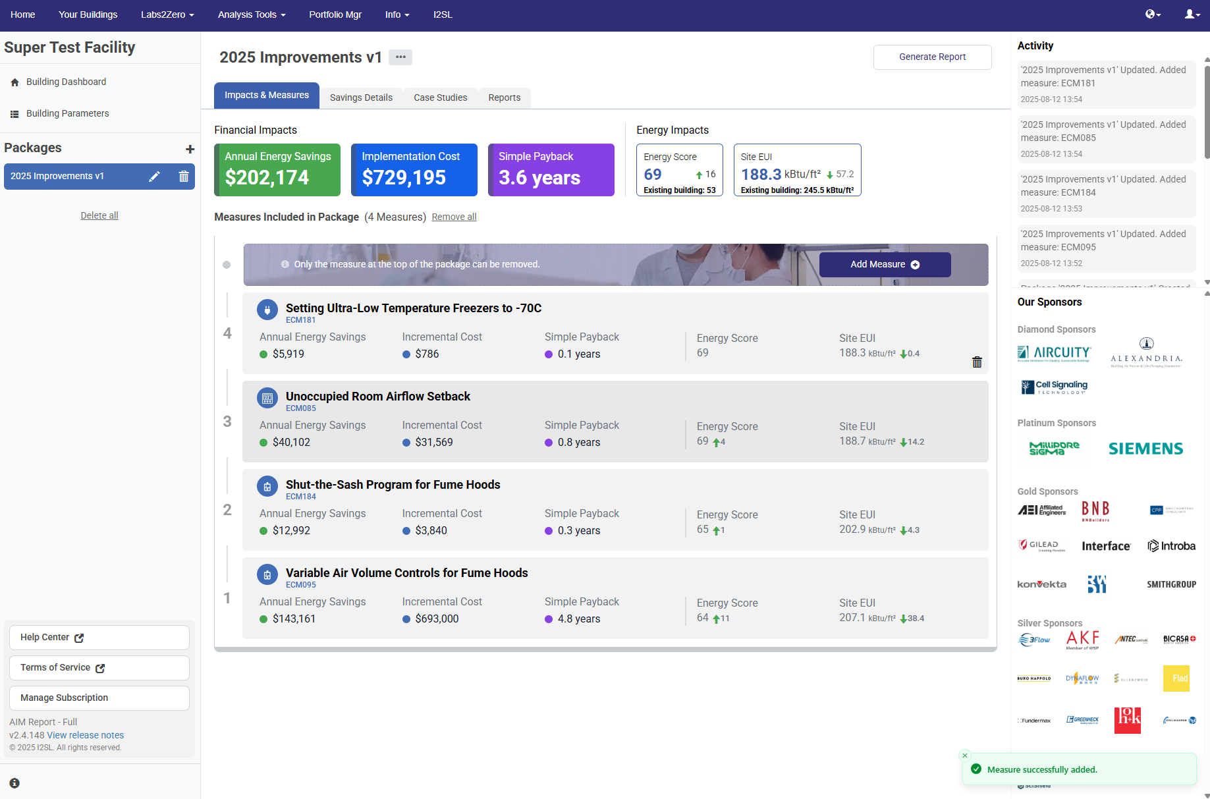
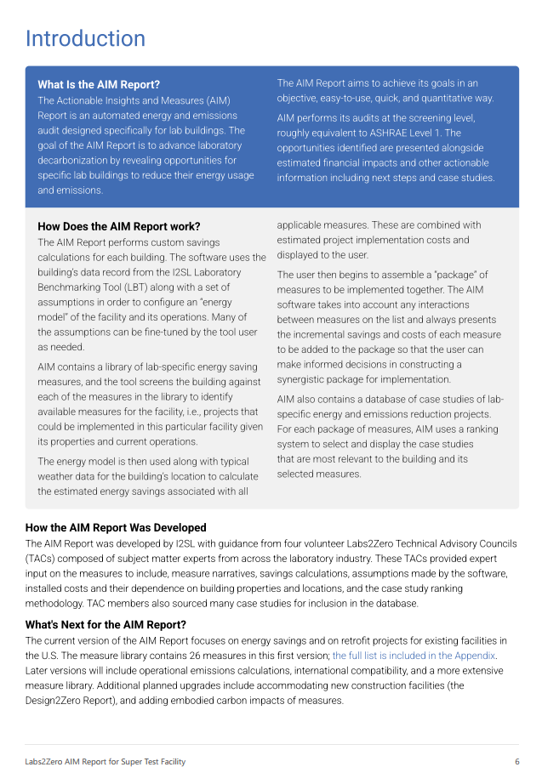
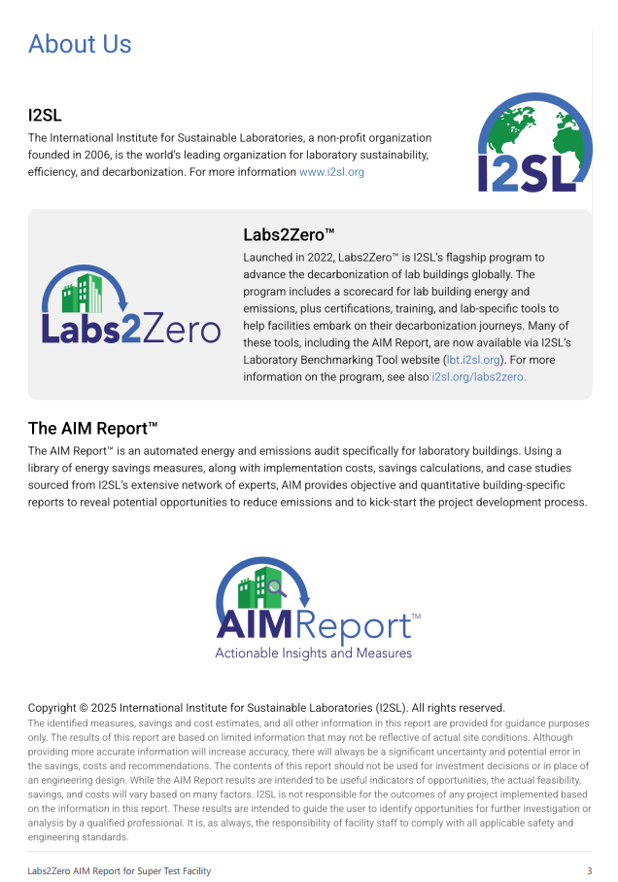
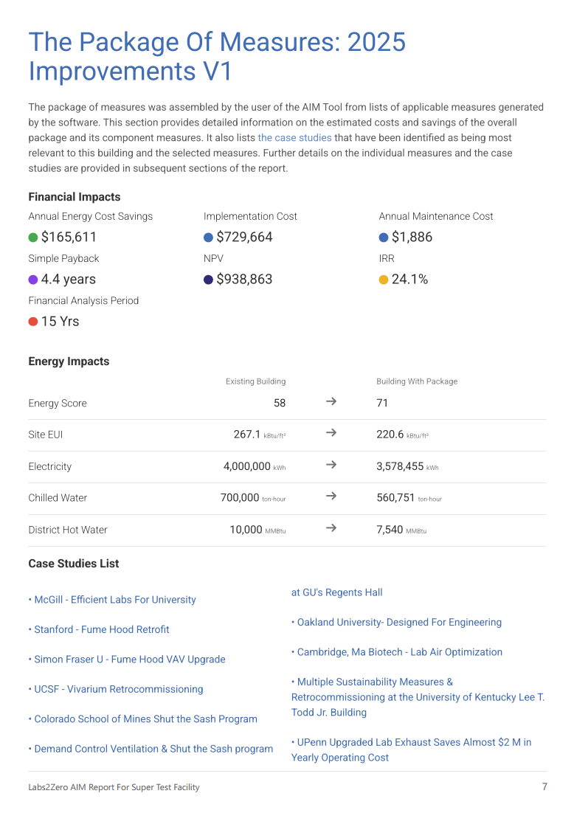
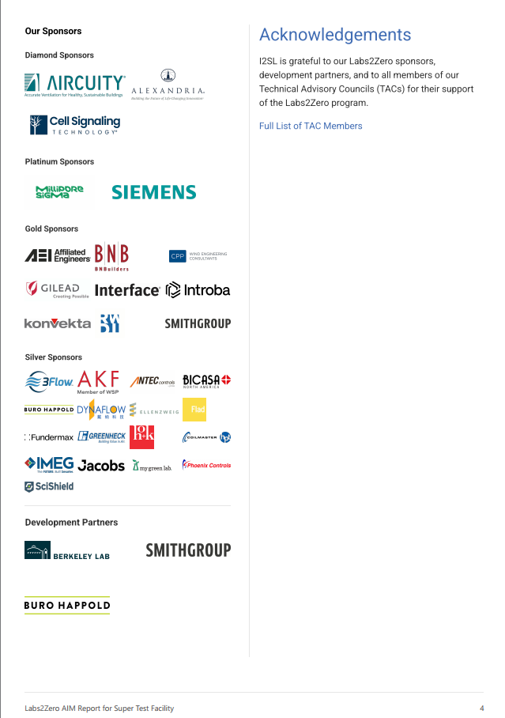
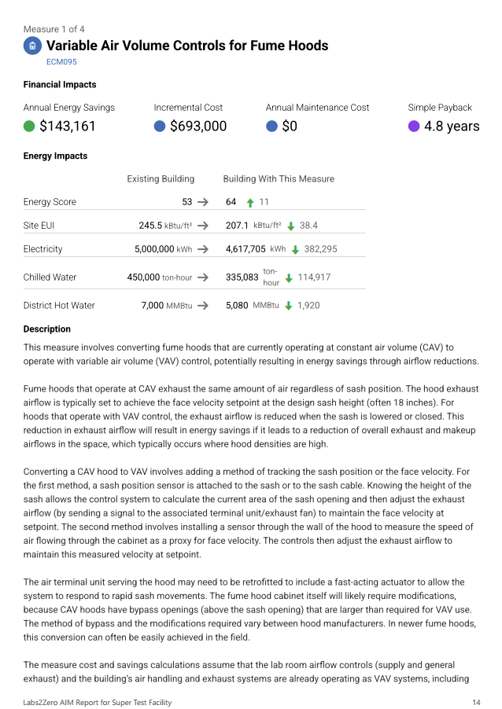
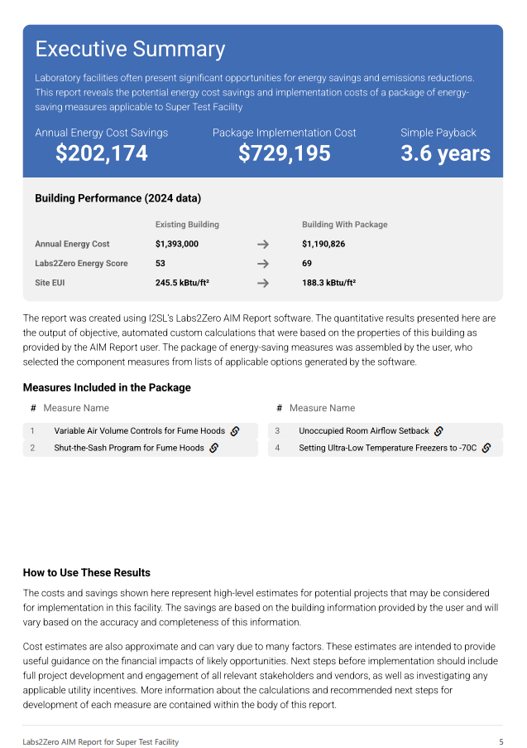
AIM Report Automated Audit Software
Relevant case studies
AIM imports your LBT building data
AIM displays available measures
You build a package of measures that is customized to your facility
PDF AIM Report
to share
AIM shows savings and costs,
next steps, stakeholders to involve
Notes:
The Actionable Insights and Measures Report, or AIM, is the first automated energy audit software made exclusively for laboratory buildings. Here’s how it works:
AIM takes the building data that a user enters into the Lab Benchmarking Tool and suggests specific measures to save energy. Then the user can build a package of measures customized to your goals and budget.
AIM calculates potential energy savings and estimated implementation costs for each measure and takes into account how these measures interact with each other.
AIM also displays relevant case studies of those measures in action in similar facilities.
AIM allows you to generate a PDF report with all of this information. A subscription to AIM allows you to generate multiple packages and reports on an unlimited number of lab buildings.
You can learn more about all these Labs2Zero tools at lbt.i2sl.org.

Slide 13
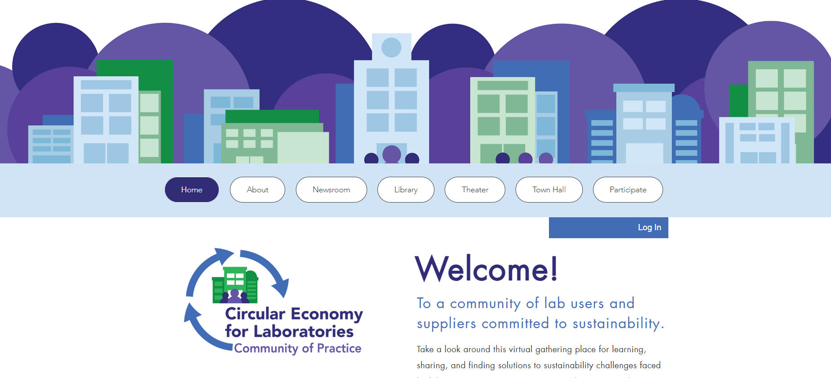
Circular Economy for Labs Community of Practice
Focused on lab waste reduction and diversion, sustainable purchasing, etc.
Free to both I2SL members and non-members to join
Interactive site with a library, Q&A forum, videos, and forums/webinars
www.circulareconomy.i2sl.org

Slide 14

Free Lab Challenges and Campaigns
LabSavers campaign promotes lab cleanup and space evaluation
International Freezer Challenge cosponsored with My Green Lab
  Optimizing cold storage management in labs around the word
  Increase ULT freezer temperatures, cleanouts, maintenance
  Winners honored at I2SL Annual Conference
Developing International Fume Hood Challenge
  Supported by Technical Advisory Groups, sponsors
  Volunteer/sponsor at i2sl.org/fume-hood-challenge

Slide 15
Find Chapter Resources at www.i2sl.org
Guide to starting a new chapter
Best practices guide for chapters
  Events/Eventbrite registration and promotion
  Sponsors/fundraising
  Bylaws
  Communications
Sample timeline, Energy Score event-in-a-box, AIM workshop
Forms/templates for financial, insurance, and administrative needs
Chapter event calendar and individual chapter web pages

Slide 16
Contact Us
Gordon Sharp
I2SL President
president@i2sl.org
Kathleen Brady
I2SL Executive Director
kathleen.brady@erg.com
Erin Pittorino
Conference Director
erin.pittorino@erg.com
Stephanie Walton
Communications Director
stephanie.walton@erg.com
General Questions
info@i2sl.org
www.i2sl.org
Jonathan Haarstick
Program/Database Manager
jonathan.haarstick@erg.com

