Slide 1


Slide 2
I2SL Vision and Mission
Vision
  I2SL will be the global leader and primary resource connecting stakeholders and providing information and education to ensure safe, sustainable, and decarbonized laboratory design, operation, and use.
Mission
  To engage diverse types of stakeholders in advancing the safety, sustainability, and decarbonization of laboratories and other high-tech facilities globally.

Slide 3
I2SL History and Structure
Initially Laboratories for the 21st Century (Labs21); in 2005, EPA and DOE’s Federal Energy Management Program (FEMP) signed an MOU with Phil Wirdzek to transition Labs21 to I2SL
Formed as a 501(c)(3) nonprofit organization in 2006
Led by a Board of Directors of 14 volunteers
Managed and staffed by environmental consulting firm ERG
Operating 15 U.S. chapters and three international affiliates
Affiliate groups: University Alliance, Sustainable Lab Forum for corporate owners, lab materials management working group

Slide 4
I2SL Members and Chapters
I2SL Membership: 600+ individuals, institutions, and lab owners
    Architects, engineers, builders, consultants, green labs professionals
    Agencies, nonprofits, academic institutions, and corporate lab owner companies
I2SL Chapters: city, state, or regional groups of professionals
  Arizona
  Colorado
  Georgia
  Great Lakes
  Greater Los Angeles
  Greater New York
  Heart of America
National Capital
New England
North Carolina-Triangle
Northern California
Pacific Northwest
San Diego
St. Louis
Texas
International Chapters
Australia
United Kingdom
China

Slide 5
I2SL Membership Benefits
Annual Conference, workshop, and Education Month discounts
Subscription discount on Actionable Insights and Measures Report
Free access to all I2SL live webinars, webinar recording archive, and Annual Conference presentation slides
Free or discounted registration to many chapter events
Qualification to participate in Technical Advisory Councils/Groups
Institutional or corporate membership that gives benefits to all employees (and students) for one price

Slide 6
I2SL Activities
Annual Conference & Technology Fair and virtual Education Week
Laboratory Benchmarking Tool
Labs2Zero program to help decarbonize the world’s laboratories
Promote and support chapters and working groups
Circular Economy for Labs Community of Practice
High-Tech Talks and other, free webinars
International Freezer Challenge co-sponsor
Smart Labs Toolkit on website in partnership with FEMP

Slide 7
I2SL Chapters [Customize for chapter]
15 regional chapters across the United States and three international affiliates
Run by industry professionals who volunteer their time
Plan educational and networking events such as lab tours, golf tournaments, breweries, and presentations
Many chapters offer free or discounted registration to their events to I2SL members
Collect sponsorships for the chapter or specific events

Slide 8
Annual Conference & Technology Fair
Premier in-person conference focused on laboratory sustainability, efficiency, and decarbonization
40+ technical sessions, pre-conference workshops, tours of cutting-edge labs, networking, and more
Exhibit hall featuring sustainable services and technologies from some of the world’s top vendors
Sponsors who receive recognition on website, mobile app, signage, and may qualify for complimentary registration

Slide 9
I2SL Education Month
A virtual, international learning opportunity for those who cannot attend the Annual Conference in person or looking to hear more from about international speakers and topics
Live presentations from industry experts and recordings of all sessions available to registrants
System optimization, decarbonization, sustainable design, and green labs from the U.S., Canada, UK, Europe, Australia, China
Webinars during the month of February, 100 percent remote

Slide 10

I2SL Labs2Zero Program
Launched in 2022 to develop tools and resources to help labs reduce energy and emissions
Tools and Technical Advisory Councils (TACs) of volunteers
  I2SL Lab Benchmarking Tool Enhancement
  Energy Score
  Operational Emissions Score
  Embodied Emissions Benchmarking
NEW! Actionable Insights and Measures (AIM) Report
  Automated energy audit for lab buildings, subscription software tool

Slide 11

I2SL Laboratory Benchmarking Tool
Rich database of lab building attributes, energy use
Foundation of all the Labs2Zero tools
Benchmarking lab buildings’ energy intensity against similar facilities’ performance in the same climate zone
Filters allow for more specific comparisons
Features international units/climate zones
All facilities with data can access a free scorecard with 1-100 Energy Score/Operational Emissions Score
We now have 1,300+ buildings in the LBT!
https://lbt.i2sl.org

Slide 12
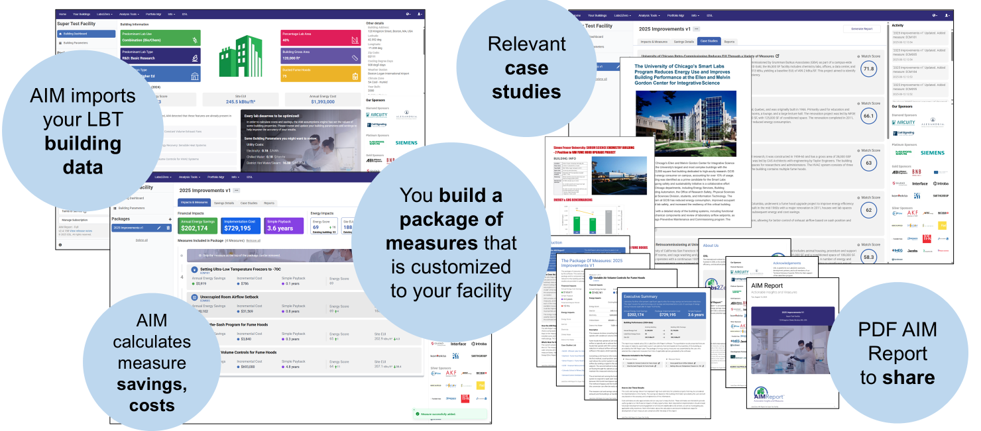
AIM Report: https:/lbt.i2sl.org/aim-report

Slide 13
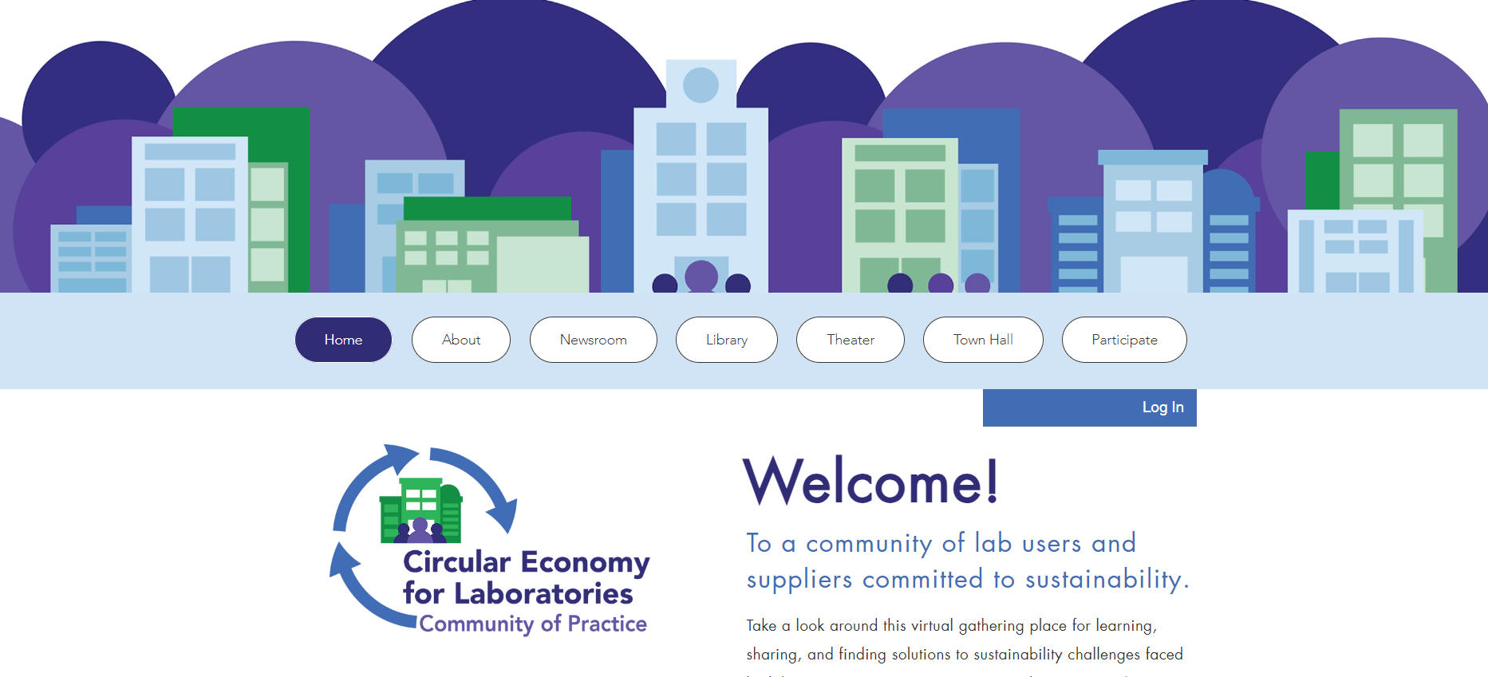
Circular Economy for Labs Community of Practice
Focused on lab waste reduction and diversion, sustainable purchasing, etc.
Free to both I2SL members and non-members to join
Interactive site with a library, Q&A forum, videos, and forums/webinars
www.circulareconomy.i2sl.org

Slide 14

Free Lab Challenges and Campaigns
LabSavers campaign promotes lab cleanup and space evaluation
International Freezer Challenge cosponsored with My Green Lab
  Optimizing cold storage management in labs around the word
  Increase ULT freezer temperatures, cleanouts, maintenance
  Winners honored at I2SL Annual Conference
Developing International Fume Hood Challenge
  Supported by Technical Advisory Groups, sponsors
  Volunteer/sponsor at i2sl.org/fume-hood-challenge

Slide 15
Find Chapter Resources at www.i2sl.org
Guide to starting a new chapter
Best practices guide for chapters
  Events/Eventbrite registration and promotion
  Sponsors/fundraising
  Bylaws
  Communications
Sample timeline, Energy Score event-in-a-box, AIM workshop
Forms/templates for financial, insurance, and administrative needs
Chapter event calendar and individual chapter web pages

Slide 16
Contact Us
Gordon Sharp
I2SL President
president@i2sl.org
Kathleen Brady
I2SL Executive Director
kathleen.brady@erg.com
Erin Pittorino
Conference Director
erin.pittorino@erg.com
Stephanie Walton
Communications Director
stephanie.walton@erg.com
General Questions
info@i2sl.org
www.i2sl.org
Jonathan Haarstick
Program/Database Manager
jonathan.haarstick@erg.com

